Slide 1
Arma-Geo Products
Design and Creation of a Geodatabase on the Colorado River Refuge Owned by Pines and Prairies Land Trust
Geography 4427
October 3, 2012
Texas State University
Notes:
Ryan will begin the introduction of the project and team members

Slide 2
The Arma-Geo Team
Ryan Henderson: Project Manager
Dustin Sablatura: Assistant Project Manager
Veronica Suarez: GIS Analyst/Graphic Design
Marcos Montelongo: GIS Analyst/Webmaster
Notes:
Each group member will step forward and introduce themselves along with their role within the group

Slide 3
Summary
The non-profit organization, Pines and Prairies Land Trust (PPLT) owns and manages multiple properties in the Central Texas region
PPLT lacks information and spatial data on their properties
To solve this problem, we will design and create a useful geodatabase that will catalogue spatial references of important features within the properties along with descriptive attribute data
Customized maps will also be created based on PPLT’s needs
If time allows, an interactive web map will be created and imbedded within PPLT’s website

Slide 4
Literature Review
Projects similar to ours
Publications on geodatabase design
Source on proper GPS procedures in the field

Slide 5
Purpose
This geodatabase will serve as an inventory and management tool for PPLT in regards to each property
Access to this geodatabase gives PPLT the power to see WHAT is on the property and WHERE it is
PPLT will have the power to see attributes and descriptive data on each feature stored in the database
Data within this database will also be useful in creating maps for staff

Slide 6
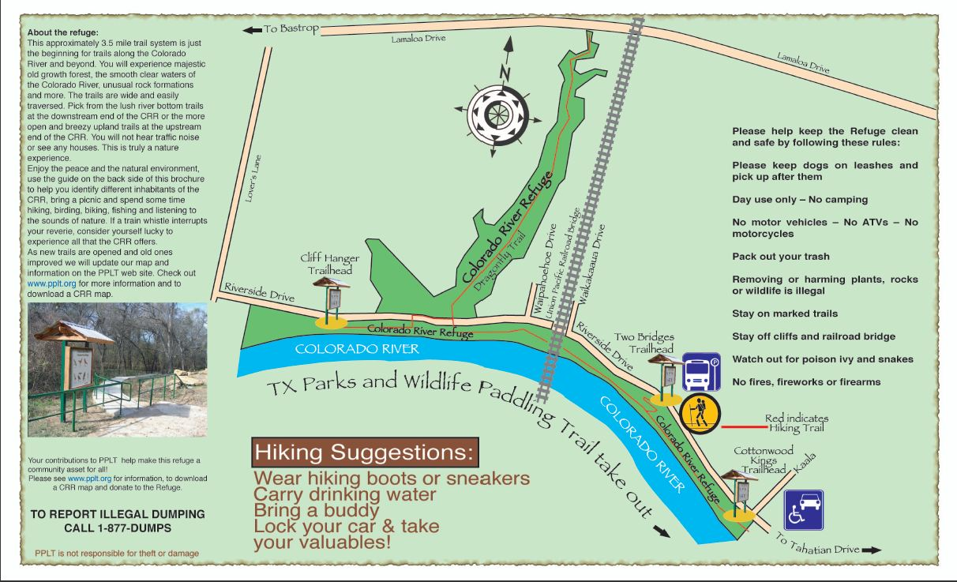
Map Improvements

Slide 7
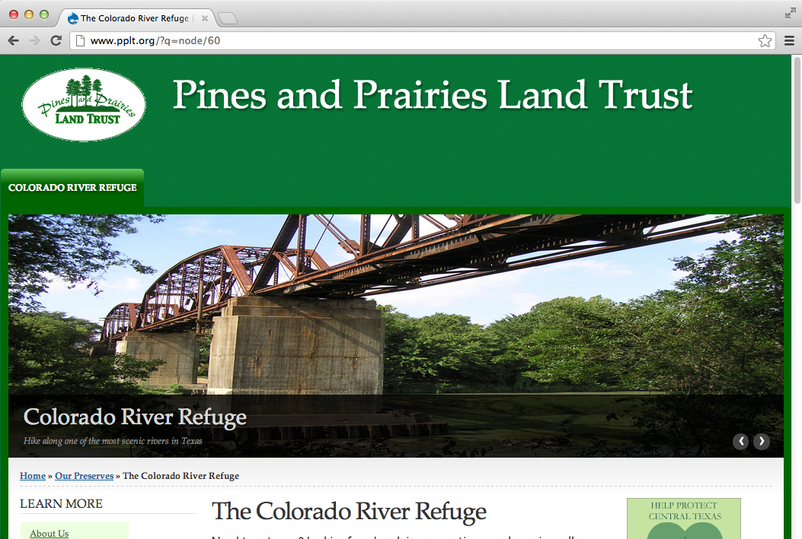
Website Improvements

Slide 9
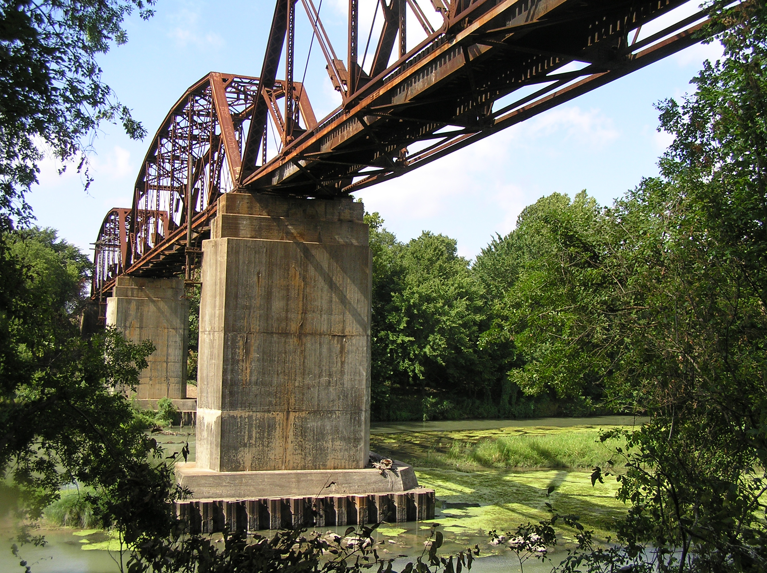
Primary Scope: Colorado River Refuge
Walking Trails
Cottonwood Trail
Dragonfly Trail
Two Bridges Trail
Cliff Hanger Trail
Trail Heads
Parking
Wheelchair Accessibly
Camping/Picnic Areas
Rest Benches along trails
Natural Elements
Colorado River (Texas Paddling Trail Canoe/Kayak Launch)
Quesadilla Cliffs
Vegetation (i.e. Cottonwood, Sycamore Trees, and Poison Ivy)

Slide 10
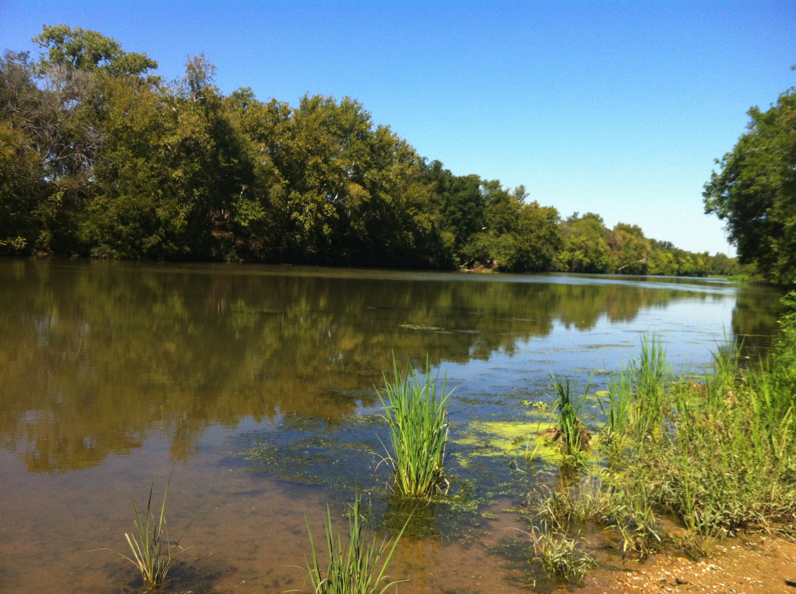
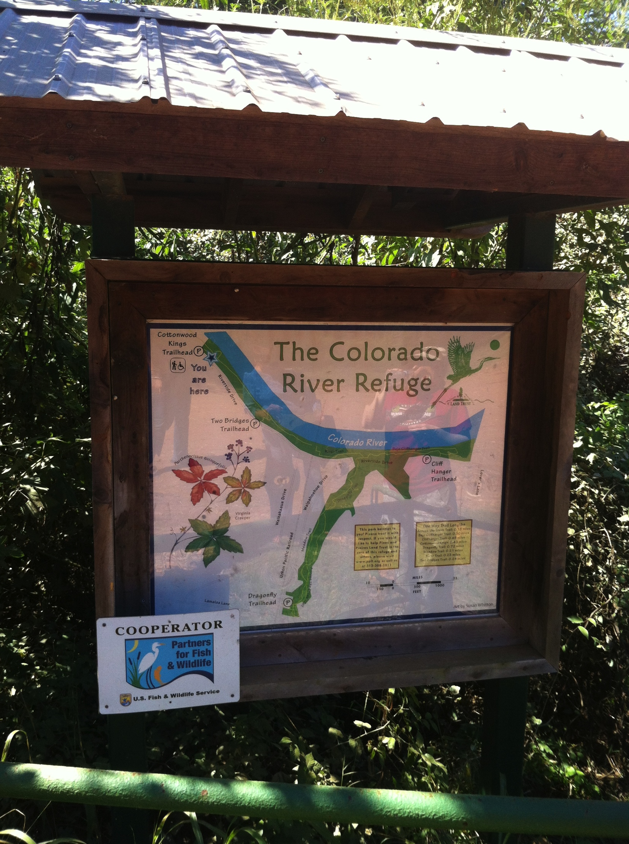
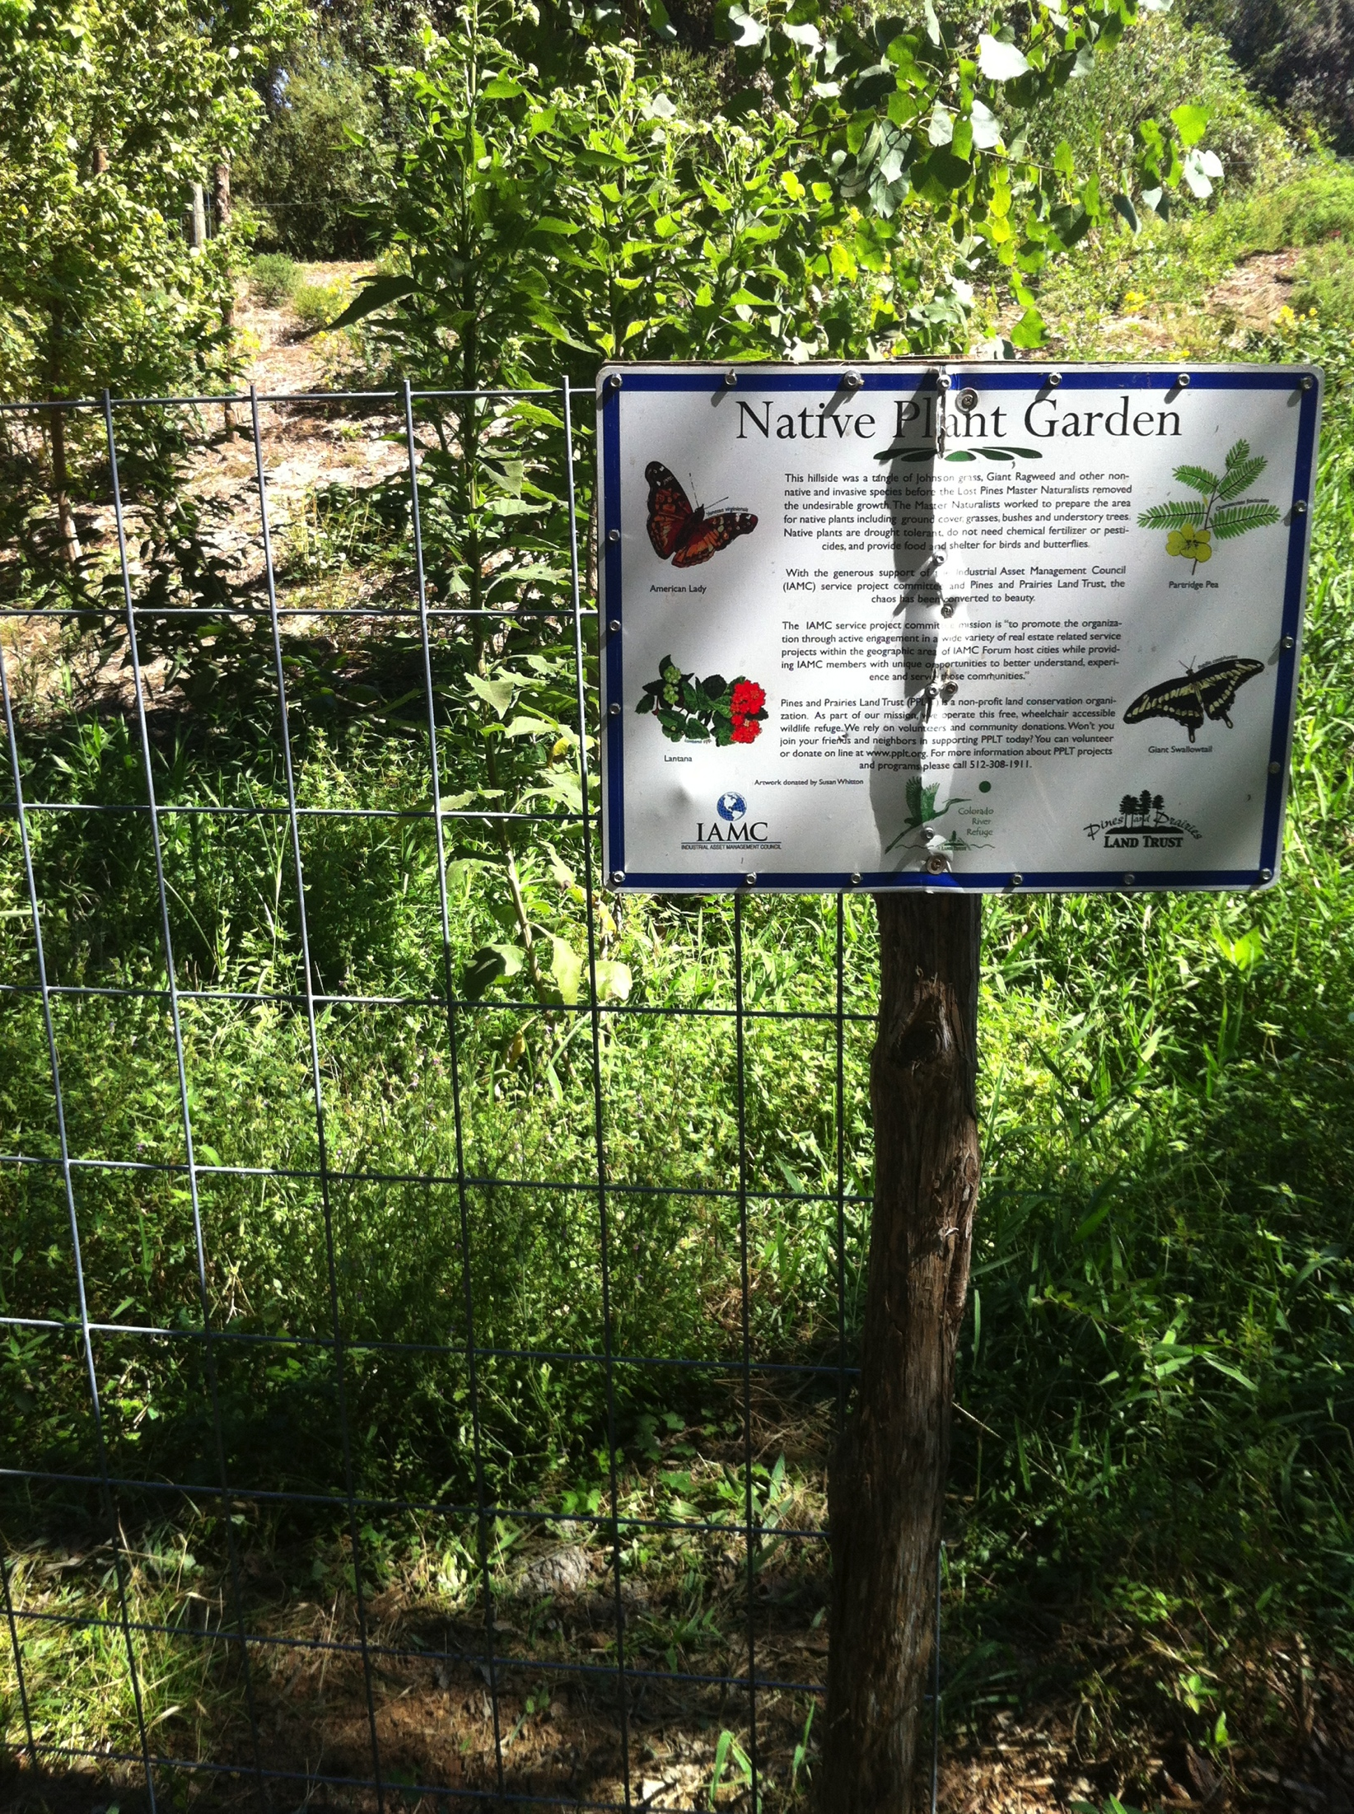
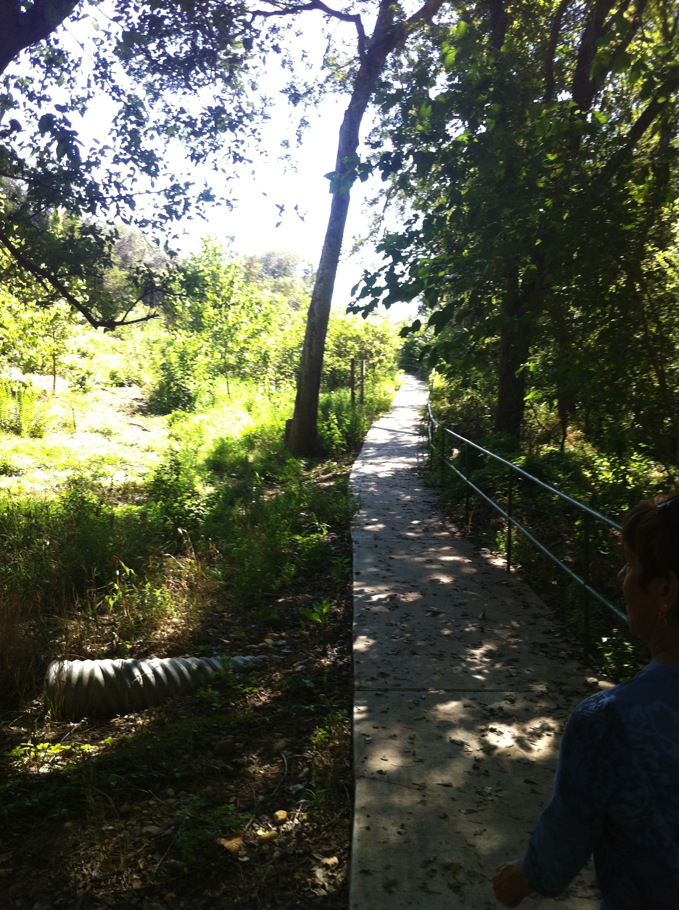
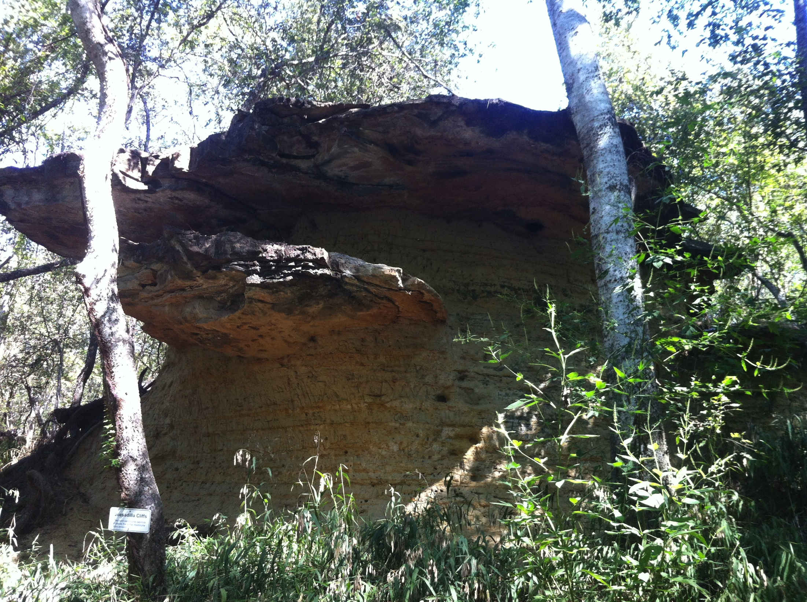
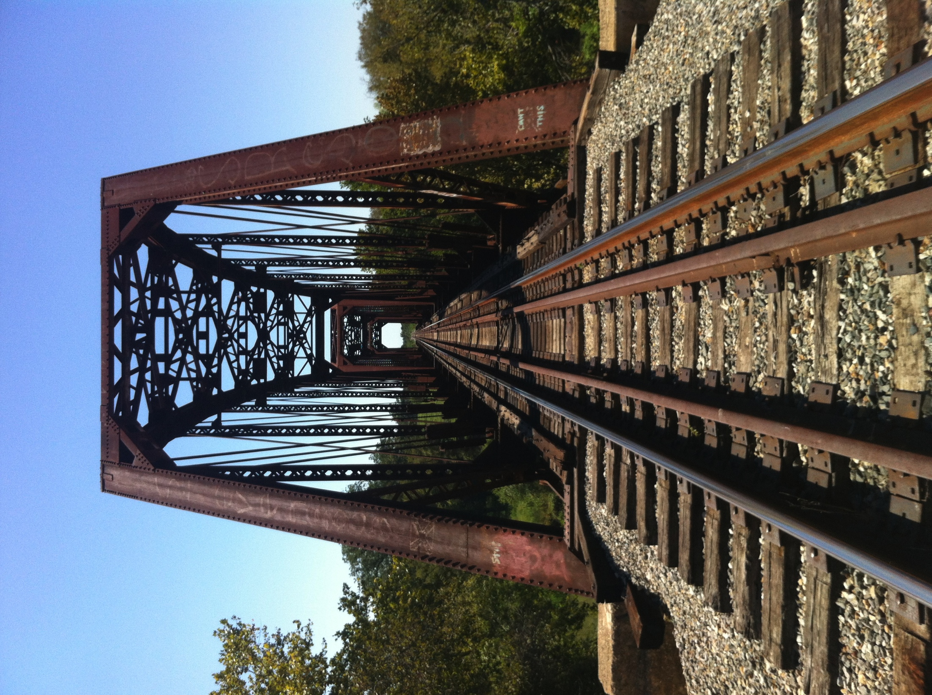
Site Assessment

Slide 11
Data
Necessary data | Sources
Colorado River Refuge | Client Supplied
Billig Ranch boundary | Client Supplied
Yegua Knobbs Preserve boundary | Client Supplied
County boundary | TNRIS
DEM of Bastrop County | TNRIS
Waterways of Texas | TNRIS
Railroad Tracks of Texas | TNRIS
Texas Roads | TNRIS

Slide 12
Data continued
Client supplied data varies in usability.
Online sources, such as Texas Natural Resources Information System (TNRIS)are helpful for providing state and county data.
Some data will need to be collected by team

Slide 13
Methodology
Delineate major features to include in the geodatabase
Each category of major features will be given its own layer with attribute tables that identify unique characteristics (geographic coordinates, levels of measurement, etc.)
Some data gathered directly from field
Handheld GPS
Coordinates entered into ArcMap

Slide 14
Methodology continued
Billig Ranch and Yegua Knobbs Preserve
If time permits, we will apply same procedures when applicable
Slope and Aspect analysis
Hard copy maps
In house and public use
Interactive map
Linkage to PPLT webpage

Slide 15
Implications
This project will meet the Pines and Prairie Land Trust’s request for the creation of a user-friendly geodatabase for the Colorado River Refuge (CRR) and potentially the Yegua Knobbs Preserve (YKP) and Billig Ranch (BR).
The data will help coordinate other existing programs to combine nature walking trails, native vegetation, and Central Texas fauna. It can be used as a resource for planning projects within the properties, and as a reference for future decisions that may impact the quality of the three properties owned by PPLT.
This study can also be used by various agencies and organizations like Texas Parks and Wildlife in their efforts to continue the preservation of natural habitats found in Bastrop County.

Slide 16
Budget
Data Collection/ GPS Fieldwork
Team Manager (1) Team Analysts (3)
Hours/ week: 12 Hours/ week: 10
Weeks: 4 Weeks: 4
Hourly wage: $25 Hourly wage: $20
Subtotal: $1200 Subtotal: $2400
Subtotal: $3600
Data Processing/ GIS Design
Team Manager (1) Team Analysts (3)
Hours/ week: 10 Hours/ week: 10
Weeks: 4 Weeks: 4
Hourly Wage: $40 Hourly Wage: $30
Subtotal: $1600 Subtotal: $3600
Subtotal: $5200
System Management
Project Manager Assistant Manager
Total Hours: 40 Total Hours: 30
Hourly Pay: $50 Hourly Pay: $40
Subtotal: $2000 Subtotal: $1200
Subtotal: $3200
Specialists
Web Master Graphic Designer
Total Hours: 25 Total Hours: 10
Hourly Wage: $35 Hourly Wage: $35
Subtotal: $875 Subtotal: $350
Equipment Costs Subtotal: $1225
Supplies: ($150 per workstation * 4 workstations) $600
Maintenance: ($100 per workstation * 4 workstations) $400
Depreciation of Equipment: ($8000 value of computers / 36 months of life * 2.5 months of use for project) $555.56
Software Costs Subtotal: $1,555.56
Arc GIS 10: ($25,000 ESRI License fee/ (12 months * 2.5months of usage) $5,208.33
Adobe Photoshop: $699 Subtotal: $5,907.33
Travel Expense
200 miles @ $0.50 /mile: $100 Total Costs: $20,787.89 Subtotal: $100

Slide 17
Timetable
Meet with client for first time
Learn their expectations for our project
Develop proposal in order to express our ideas and direction for the project
Collect data by way of manual GPS plotting
Gather any data we can find on the internet or from Pines and Prairies Land Trust
Check data for quality
Prepare the data to be managed in a GIS
Create the GIS database
Produce high quality maps that can be used both in house by PPLT and for public use in brochures and kiosks
Develop a professional website that is easy to navigate and exceptionally informative
Include an interactive map that educates the public on important features in the Colorado River Refuge
Prepare final deliverables

Slide 19
Final Deliverables
CD/DVD containing all data
Metadata
Power Point Presentation
Professional Posters for display at PPLT and Texas State
Website
Instructions for PPLT on how to use data on CD (readme file)
Final Maps to be used for PPLT brochures and trail heads
Final Report

Slide 20
Conclusion
Our primary focus is in designing and implementing a useful geodatabase for PPLT
This geodatabase will be populated with data related to features found within the properties
Spatial data
Descriptive attribute data
Utilizing this geodatabase will enable PPLT to monitor and manage their properties while making improvements through future projects
This collection of data will allow for a thorough inventory on each property, and can be visualized by creating maps for staff and visitors
PPLT will have a resource that other GIS analysts can use for future analysis on the properties

Slide 21
References
Carillo, Jacqueline, Christensen, Scott, Dillashaw, Bradley, McGauhey, Kelly, and Ortega, Sam. 2011. Construction of Database for the New Braunfels Public Works Department. San Marcos, TX: Texas State University.
Baker, Michael, Jr. Updated GIS Database Design: Geodatabase Model. Virginia Beach, VA. http://www.suffolkva.us/gis/docs/database-design.pdf. (last accessed 29 September).
Perkins, Kent, and D., Robinson, Joshua. 2008. Best Practices for Collecting Geographic Data in the Field. Gainesville, FL. http://www.flmnh.ufl.edu/herbarium/methods/Georeferencingbestpractices.htm. (last accessed 29 September).

Slide 22
Questions?

